Slide 1
Online Toll Processing System
Guide : Ms. PCD.Kalaivaani
Akilan.M 13CSR010
Dharaneeshwaran.R 13CSR034
Gopi.T 13CSL232

Slide 2
Problem Statement
Waiting in a long queue
Managing the collected toll amount is a complex process
Maintenance
High human intervention

Slide 3
Existing Methodologies
Adaptive Thresholding
Method for generating the binary image
Connected Component analysis
To identify the character outlines
Find lines and words
Using character outlines find the individual words
Recognize the word by 2 passes

Slide 4
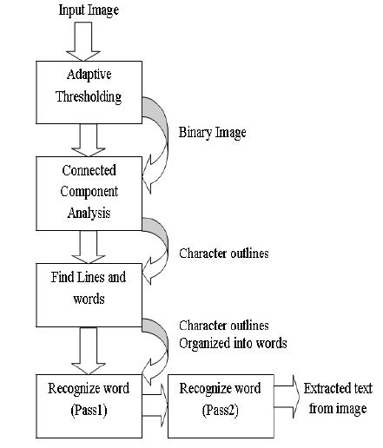
Flowchart of Tesseract

Slide 5
Proposed work
User can pay for the toll before going through Toll
User need to register himself with personal details and the vehicle details
While the vehicle pass through the toll recognize the Vehicle number by the Tesseract module
Check database for the reference of user’s payment
If he paid the toll, allow him to pass through or else not allow him

Slide 6
Example Setup

Slide 7
Modules
User registration
Payment of toll
Vehicle number extraction
Compare and let it to go
Maintenance of the user

Slide 8
Experimental Setup
Tesseract open source module
Amazon AWS
Digital Camera(720X540)

Slide 9
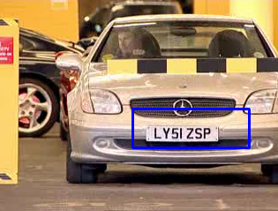

Slide 10
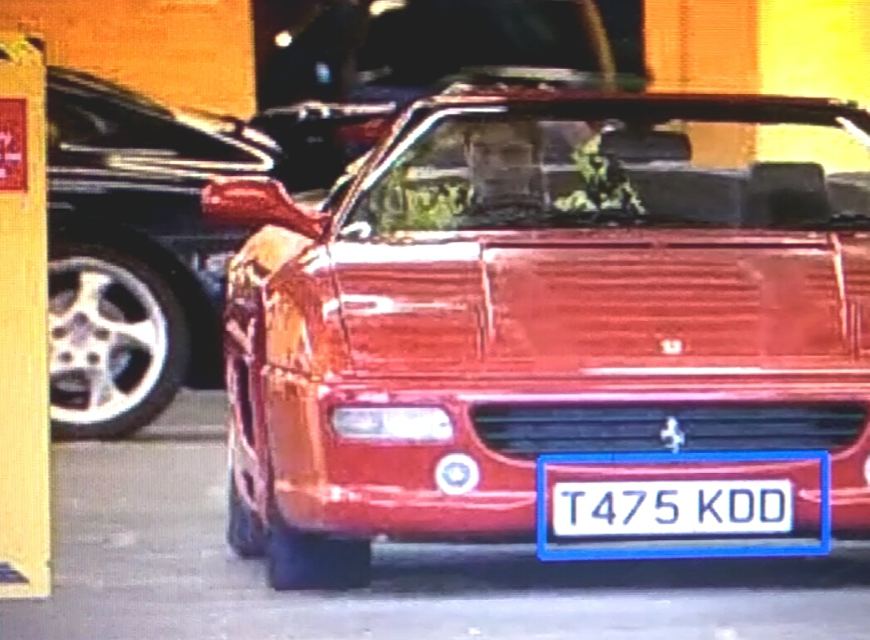

Slide 11



Slide 12
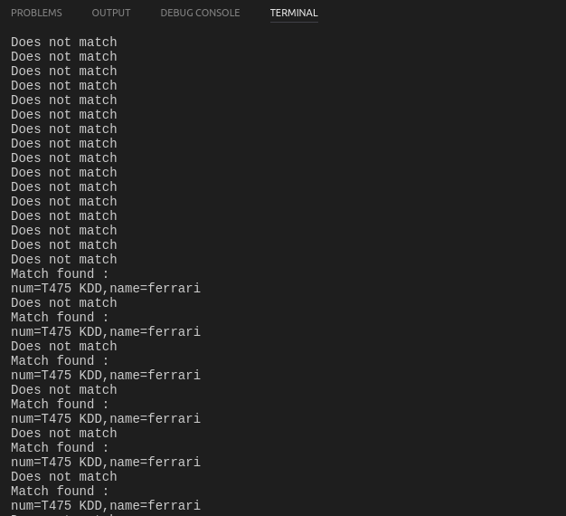

Slide 13
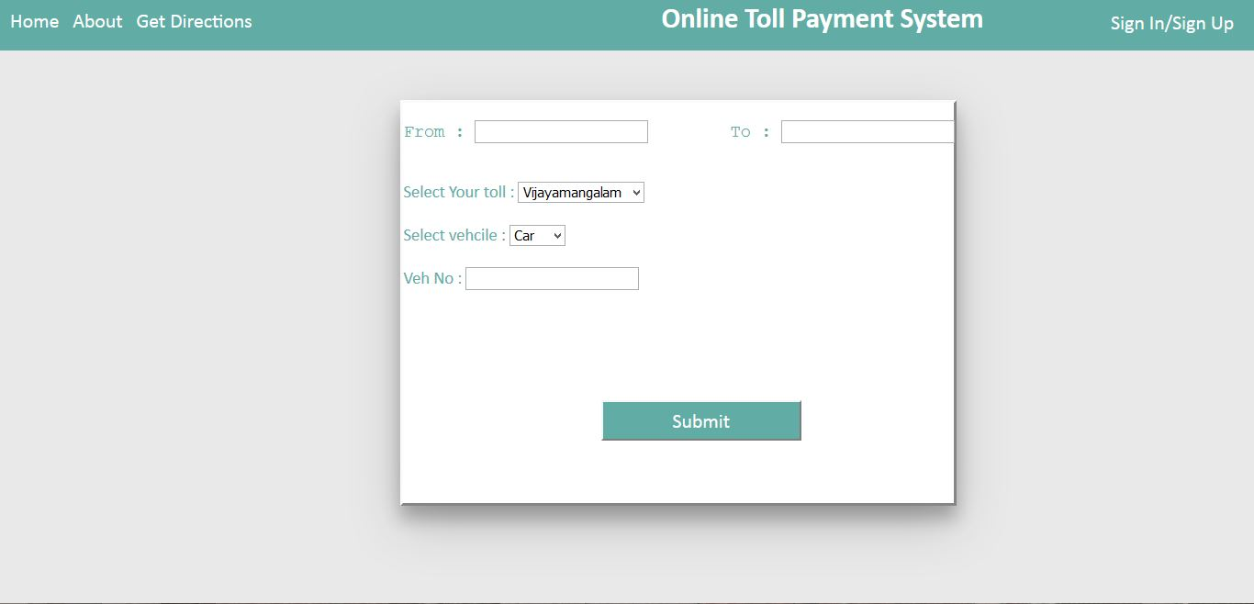
Homepage

Slide 14
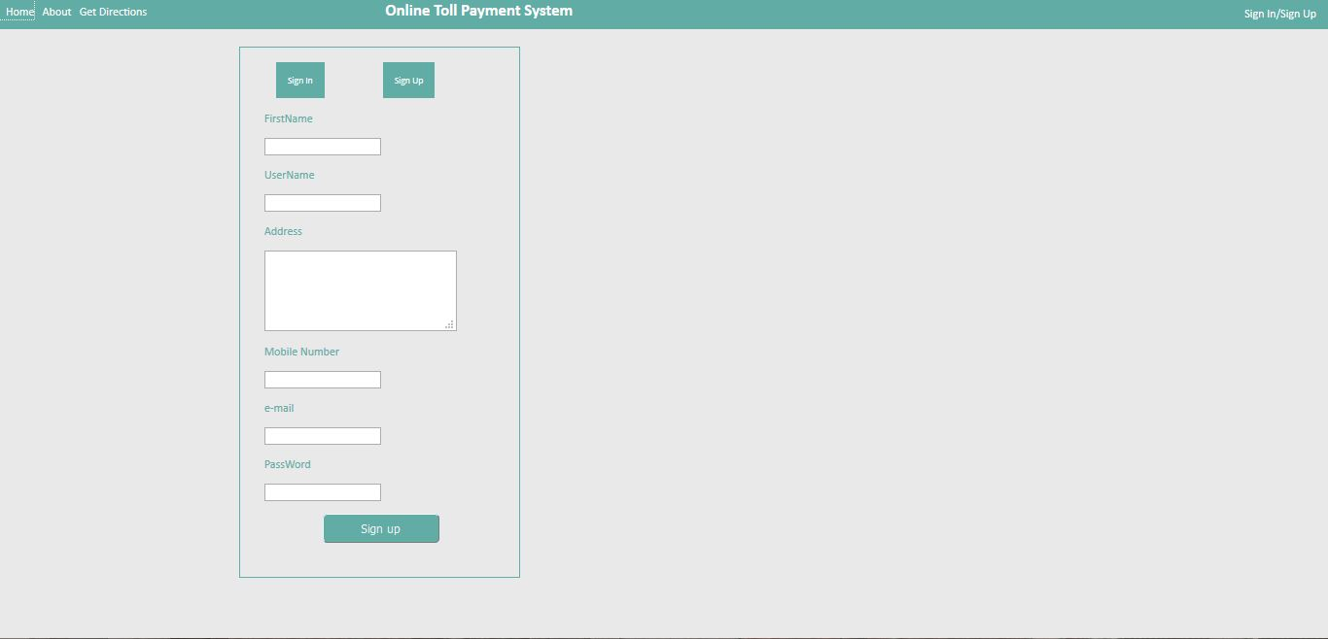
User Sign up

Slide 15
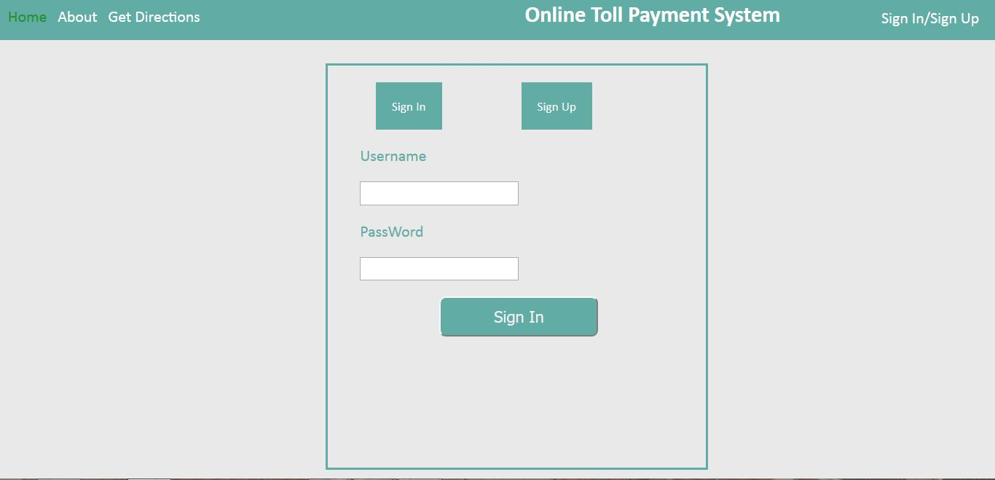
Sign in

Slide 16
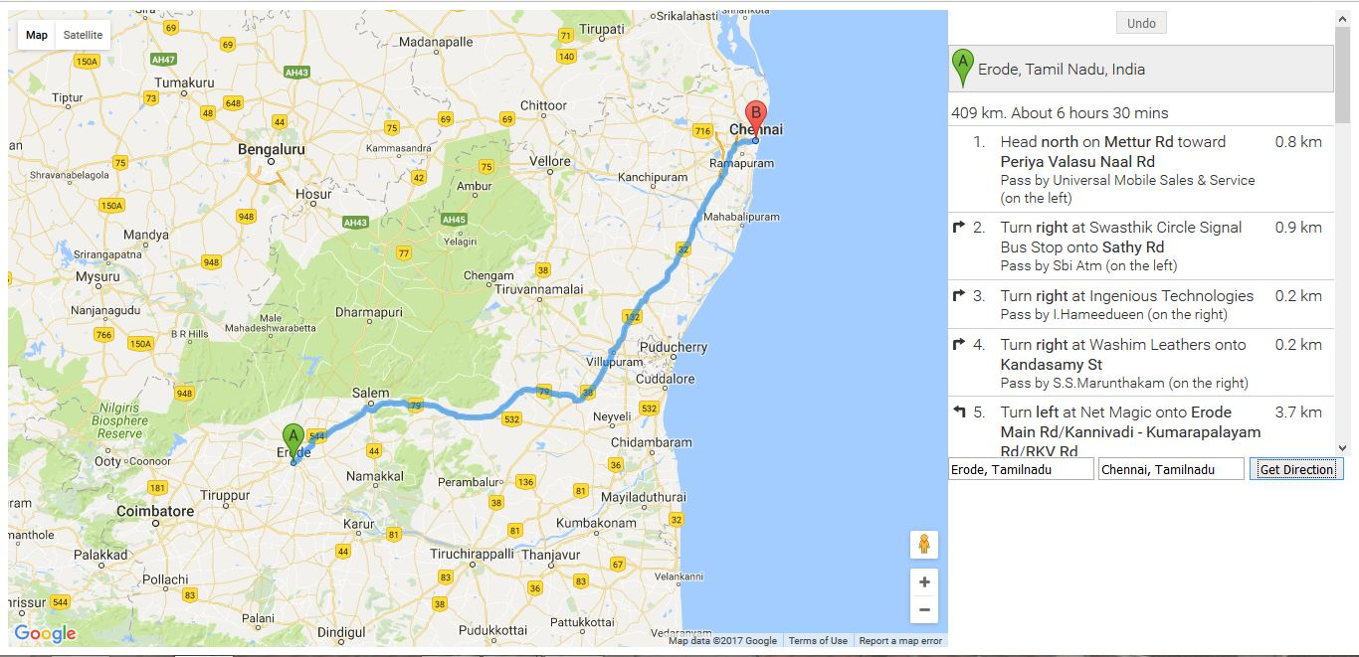
Map

Slide 17
Queries !!!

